Slide 1

XBRL Reporting

Slide 2
Agenda
The Tool for Undertakings (T4U/TFU)
MFSA Licence Holders' Web Portal
Submission of files to MFSA
XBRL Validation Process
T4U – The Way Forward
Q & A

Slide 3

Tool for Undertakings a.k.a. TFU / T4U
Tool for Undertakings can be downloaded from http://t4u.eurofiling.info/
  Minimum Requirements: Workstation with Windows OS and Microsoft.NET Framework 4.0+ installed.
Step-by-step guidance is available in the User Manual which can be downloaded from the Help drop-down menu.

Slide 4
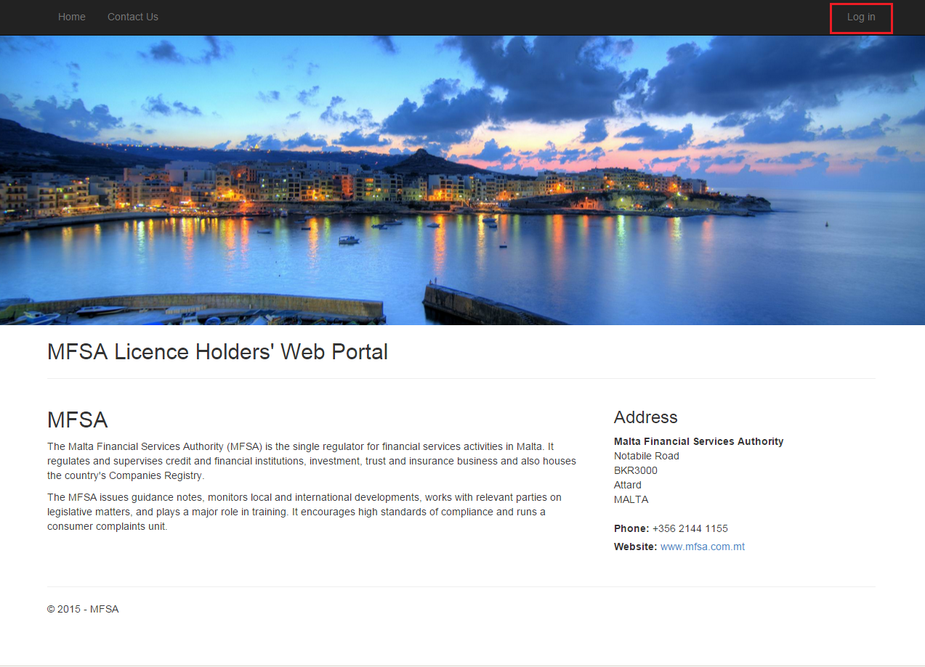
LH Portal
DEMO

Slide 5
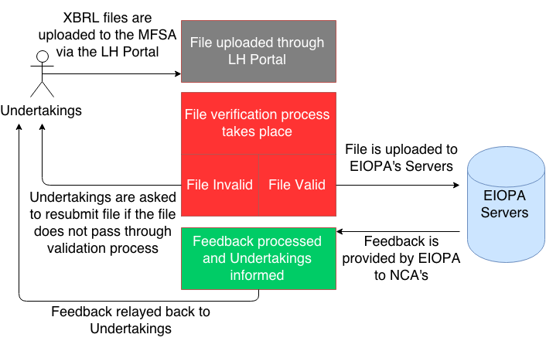
XBRL Validation Process

Slide 6

T4U – The Way Forward
EIOPA communicated the following developments to stakeholders:
  EIOPA will maintain the T4U till Q3 2015 which will be the first full Solvency II release.
  T4U should keep on functioning but no further developments will be released on the final version of the tool.
  As a result one cannot assure that the T4U can keep on meeting future demands of EIOPA for XBRL reporting.

Slide 7

T4U – The Way Forward
Entities can opt to maintain the tool themselves via their IT resources:
  T4U is based on the Arelle project which is an Open Source project used by the Eurofiling community. Further information can be found on http://eurofiling.info/solvencyII/index.shtml and http://arelle.org/
Procure a commercial off-the-shelf (COTS) third- party XBRL tool:
  XBRL International provides a list of approved vendors - https://www.xbrl.org/the-consortium/resources/tools-and-services.
  Cost varies starting from around €30,000 upwards.

Slide 8
T4U – The Way Forward
MFSA Insurance and Pensions Supervision Unit will initially be using the T4U.
However, from experience obtained from the Banking Supervision Unit, who had similar reporting requirements, a commercial off-the-shelf XBRL tool was procured and has been used without any major issues for the past year.
In view of these developments we encourage Undertakings to start looking into these tools to avoid unnecessary surprises when EIOPA stops maintaining the T4U.

Slide 9

Notes:
Most salient points gathered after questions raised by the audience:
LH Portal-related FAQs:
Will Managers have more than one username?
Yes, managers should have received a username and password for each undertaking they manage.
Can you clarify the file status process?
For the 1st submissions, once an undertaking uploads a file, the LH Portal will prompt you on screen whether the file has been uploaded successfully or not. On successful file submissions, an email notification is also sent to the logged in user notifying him/her that the file was uploaded successfully to MFSA. In future releases, when further checks will be added namely by EIOPA, users should keep on monitoring the status of the submitted files from the portal since more file statuses will be added. When the whole process in relation to a specific file upload is ready, apart from having the file status updated in the portal itself, an email notifying the user with the final status will be sent as well. Like this, if something went wrong with the submitted data, then undertaking would know from the final status of the file and/or the last email sent after the whole process and undertaking would require to modify reported data and re-submit file through the LH Portal. Whole process will be triggered once again. Kindly note that as explained during the presentation, for the first release, there will be only 1 status – “File uploaded to MFSA“ followed by an email notification. In case a re-submission is required analysts from the MFSA Insurance and Pensions Supervision Unit will contact you via email to modify reported data and re-submit using the LH Portal.
Will other submissions to MFSA occur through the LH Portal?
The intention is to keep on adding all type of reporting, being quantitative and also qualitative like the narrative reporting through the same portal. Instructions will be communicated to undertakings when other type of submissions are due. For now the portal is already accepting submissions in relation to the Business of Insurance Intermediaries Statistics and now with the latest release it also caters for the following Principals-related reporting:
PQRTA - Annual Preparatory QRTs
PQRTQ - Quarterly Preparatory QRTs
PNR - Preparatory Narrative Reporting
FLAOR - FLAOR Reporting
In due course the following reporting will also be added to the LH Portal:
NSTA – Annual National Specific Template
NSTQ - Quarterly National Specific Template
QRTA - Annual QRTs
QRTQ - Quarterly QRTs
NR – Narrative Reporting
ORSA – ORSA Reporting
MNGT – Management Accounts
AFS – Audited Financial Statements
For further information and time-frames kindly refer to circulars issued by MFSA found on the MFSA Website (http://www.mfsa.com.mt/pages/viewcontent.aspx?id=212) namely:
http://www.mfsa.com.mt/pages/readfile.aspx?f=/files/Announcements/Circulars/Insurance%20and%20Pensions/Solvency%20II/250315_Circular_New_web_portal_Principals.pdf
If something unexpected occurs during file upload where can undertakings contact MFSA?
Undertakings can contact MFSA through the Contact Us page and we will get back to you. If you have problems accessing the portal you can also send an email on ipsu@mfsa.com.mt
XBRL Tool-related FAQs:
Can MFSA suggest a preferred XBRL tool?
MFSA: No, as an authority this is not possible. We encourage you to go through an evaluation process similar to what MFSA did for the Banking Unit.
Is it necessary that undertakings buy the same tool like the one chosen by the authority?
No, it is not necessary. Any XBRL tool compliant with the latest XBRL standards and that is capable to validate generated XBRL files against SII taxonomies issues by EIOPA, is able to generate valid XBRL files.

